Slide 1
Case Study: Data Engineering Methodologies in Telecom
Bootcamp FY25
Vridhi Ritesh Sachdev
Pranshu Sinha
Sanskar Sinha
Beulah Pappula

Slide 2
Agenda
1.
Problem Definition
2.
Tech Stack
3.
Architecture
4.
Implementation
5.
Demo

Slide 3
Problem Definition
Business Context
In the highly competitive telecom industry, maintaining seamless network performance and high customer satisfaction is crucial for customer retention and business growth.
Monitoring and analyzing real-time network data and customer complaints is essential to quickly resolve issues, reduce customer churn, and improve service quality.
Objectives
Build a robust ETL pipeline for real-time processing and monitoring of network data.
Develop analytics to assess network performance (call drop rates, data speeds, signal strength) in real time.
Perform complaint analysis to monitor complaint resolution time and customer satisfaction.

Slide 4




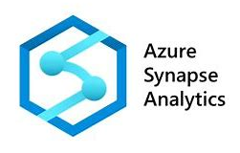



Tech Stack
Apache Kafka
Real-time data streaming and processing platform
Azure Data Factory
Service for data integration and workflow orchestration.
Databricks & Delta Live Tables
Unified platform for data engineering and analytics
PowerBI
Business intelligence tool for interactive visualizations

Slide 5
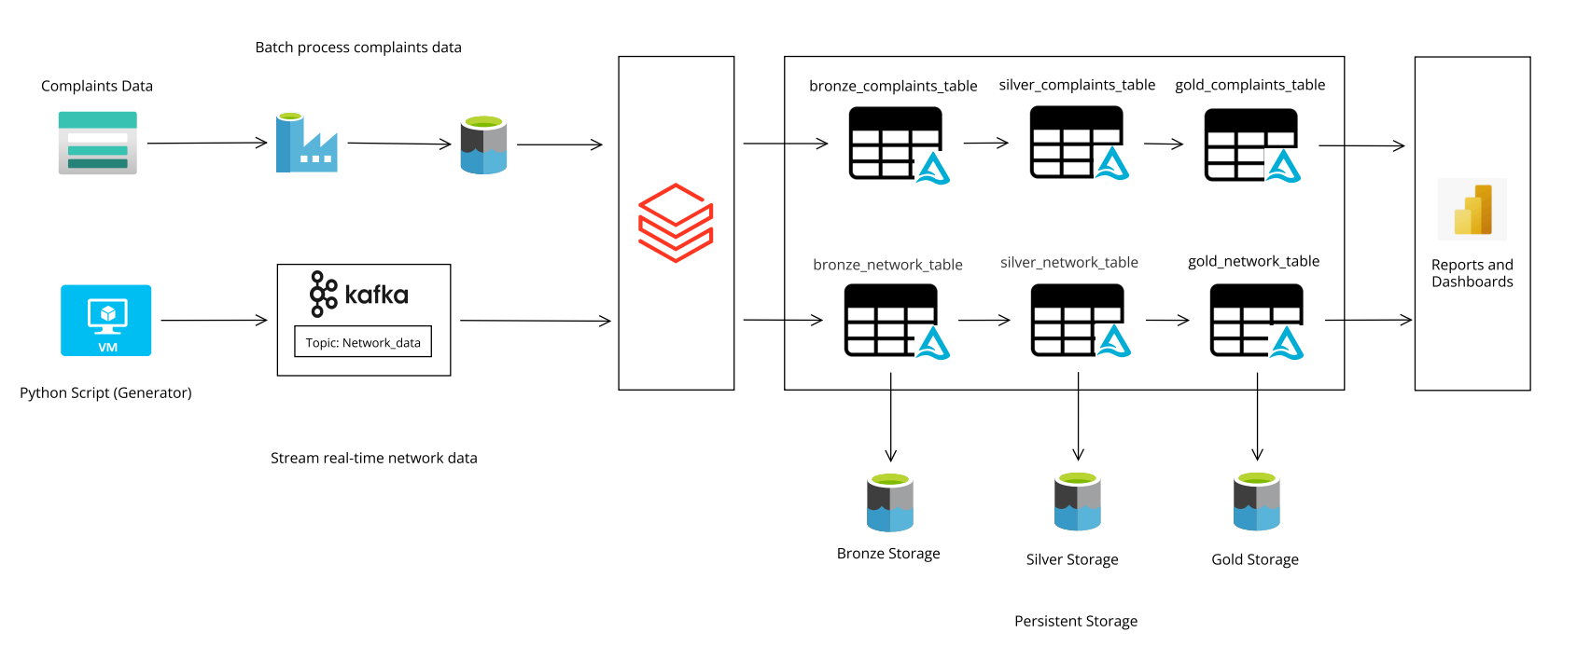
Architecture

Slide 6
Implementation

Slide 7
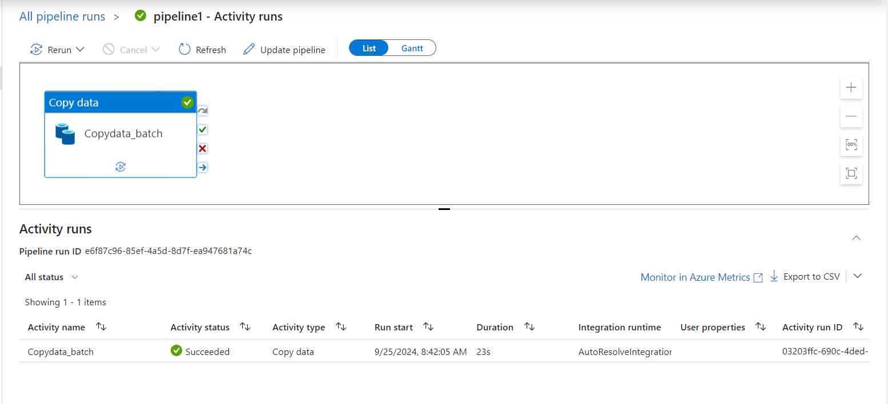
Batch Ingestion using ADF

Slide 8
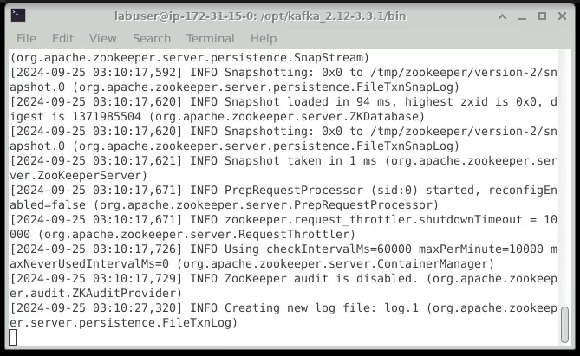
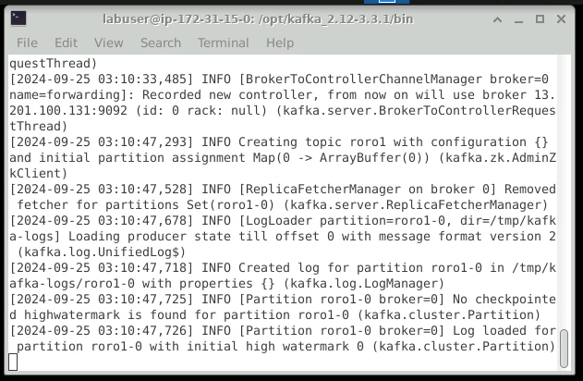
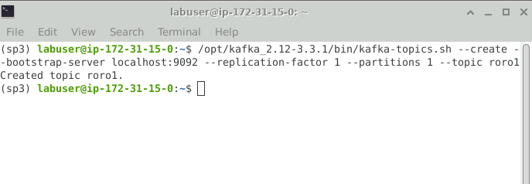
Setting up Kafka
Configure Zookeeper
Configure Kafka Server
Create Topic

Slide 9
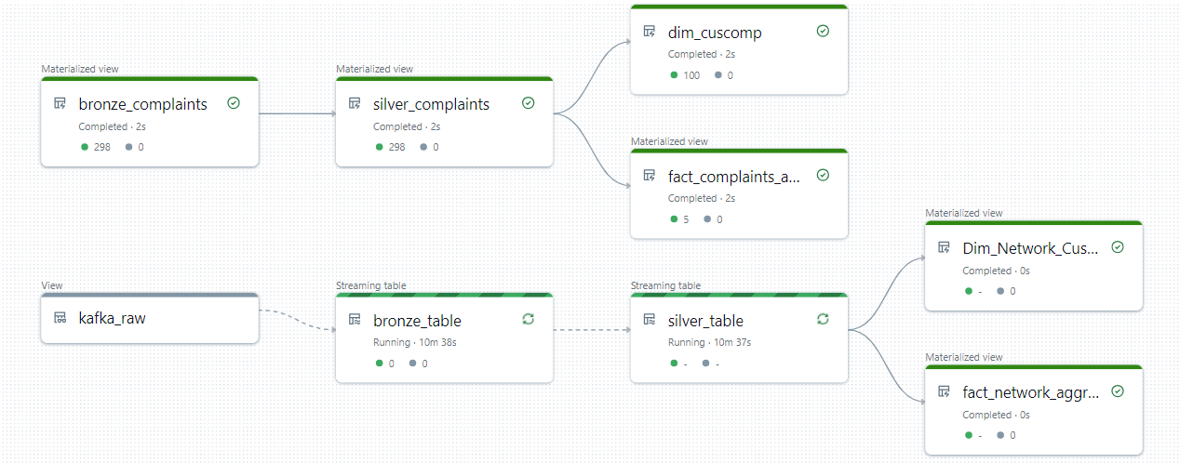
Databricks Workflow

Slide 10
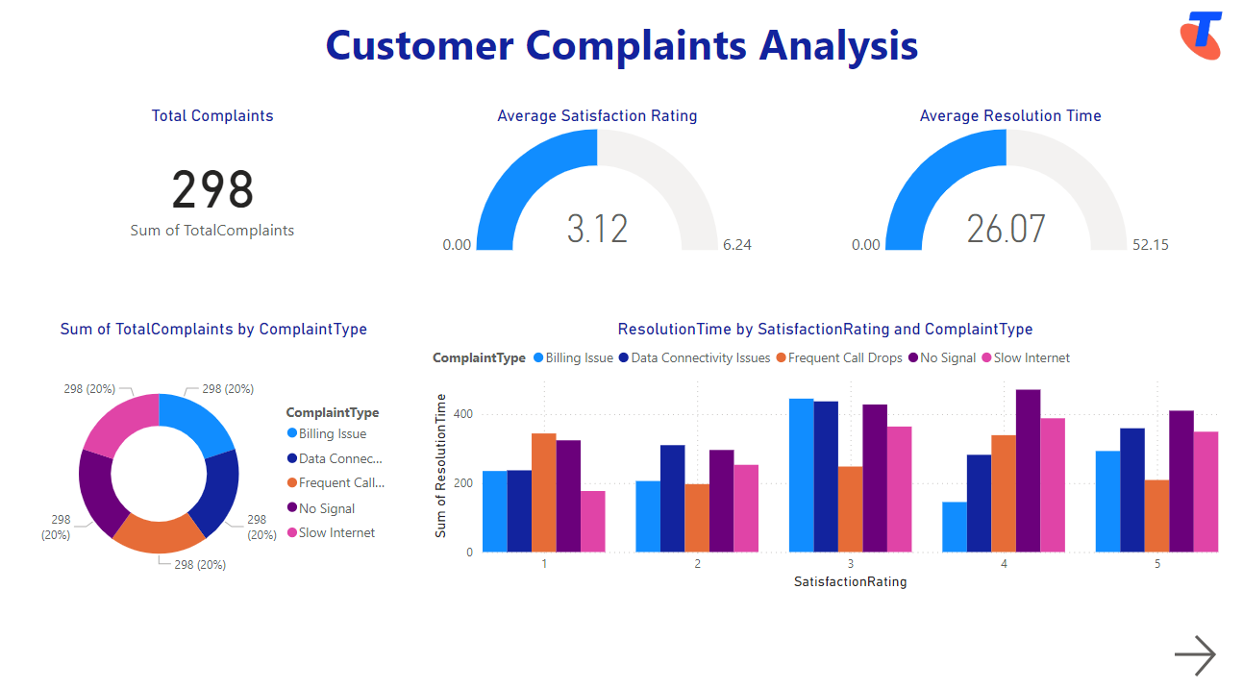
PowerBI Dashboard

Slide 11
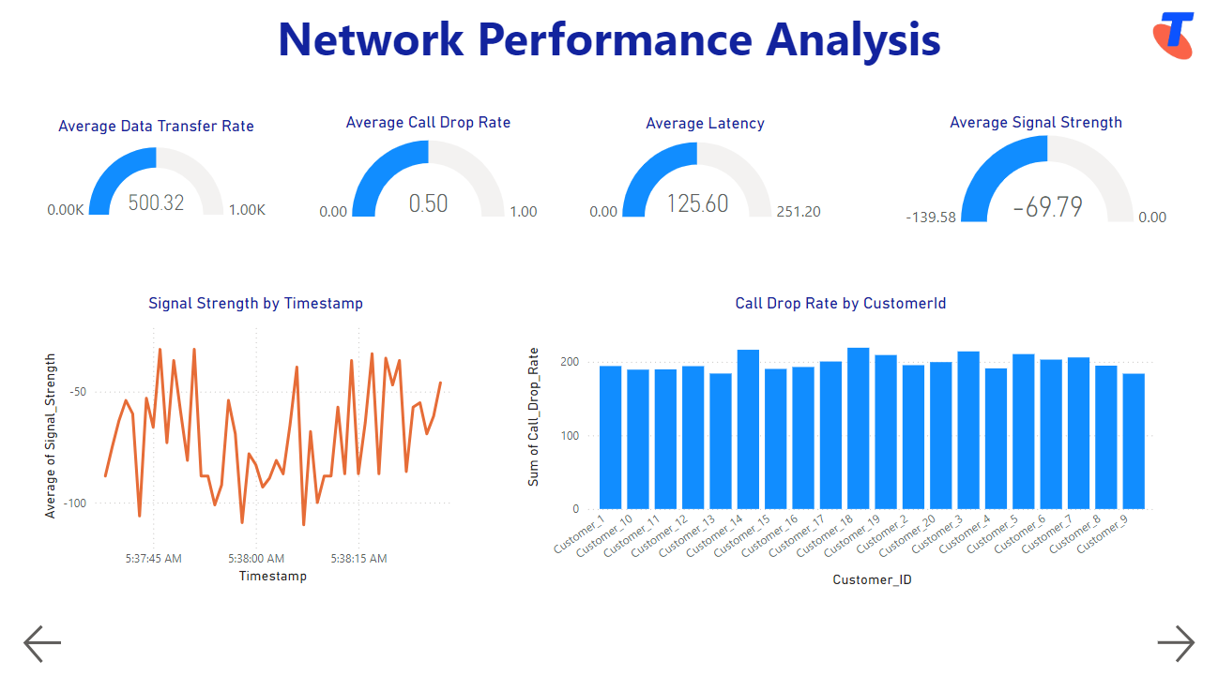
PowerBI Dashboard

Slide 12
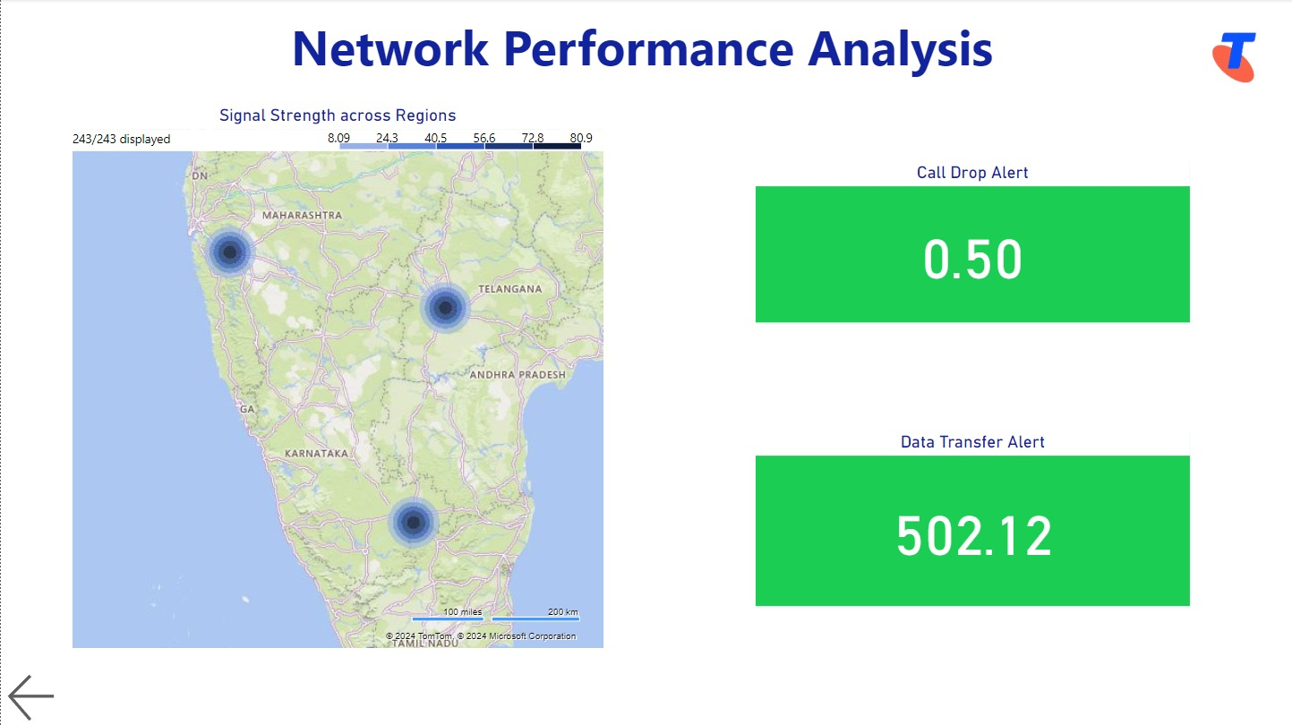
PowerBI Dashboard

Slide 13
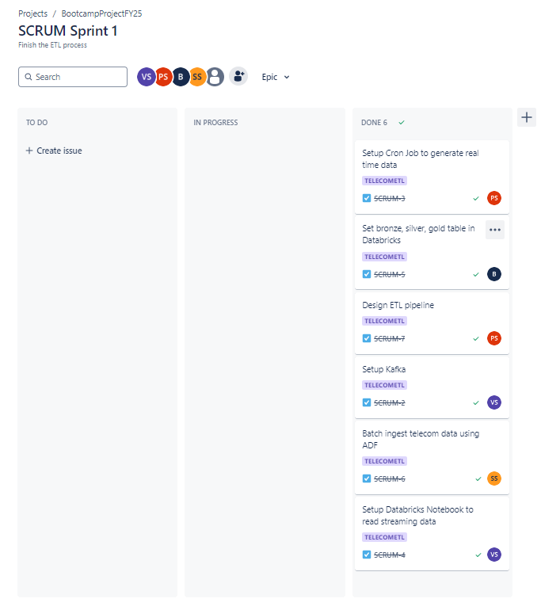
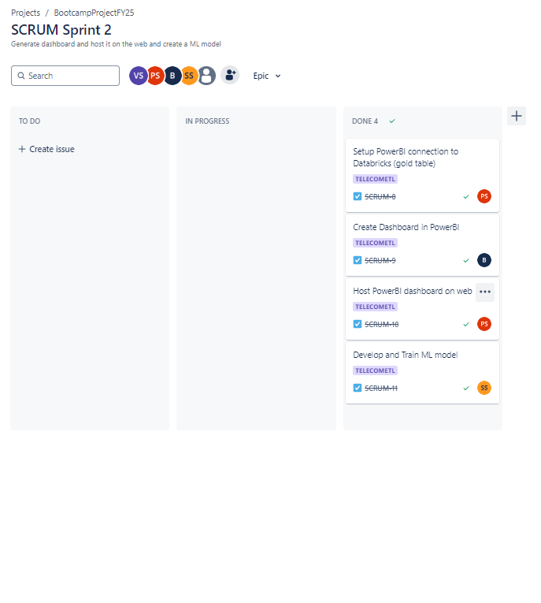
Project Management

Slide 14
Live Demo

Slide 15
Challenges
Ensuring Clean Architecture: Directly connecting Azure Blob Storage to Databricks can present challenges related to data accessibility, security.
Configuring Kafka: Complexities in setting up a secure and stable connection for real-time data streaming
Databricks ETL Pipeline failures: Frequent interruptions due to code inefficiencies, resource allocation issues, or data quality problems

Slide 16
Conclusion & Future Enhancements
Conclusion
Comprehensive ETL Pipeline: Successfully implemented an end-to-end ETL pipeline integrating real-time and batch data using Kafka, Databricks, and Azure Data Factory.
Effective Analysis: Utilized Delta Lake and Power BI for efficient data processing and insightful dashboard creation.
Future Enhancements
Advanced Analytics: Implement more sophisticated machine learning models and real-time anomaly detection.
Improved Security: Implement security protocols to encrypt data in transit and at rest and address emerging threats and compliance requirements.

Slide 17
Thankyou
Any Suggestions and Enhancements?
Github Repo

